Slide 1
The Data Link Layer
UNIT-2

Slide 2
Data Link Layer Design Issues
Services Provided to the Network Layer
Framing
Error Control
Flow Control

Slide 3
Functions of the Data Link Layer
Provide service interface to the network layer
Dealing with transmission errors
Regulating data flow
  Slow receivers not swamped by fast senders

Slide 4
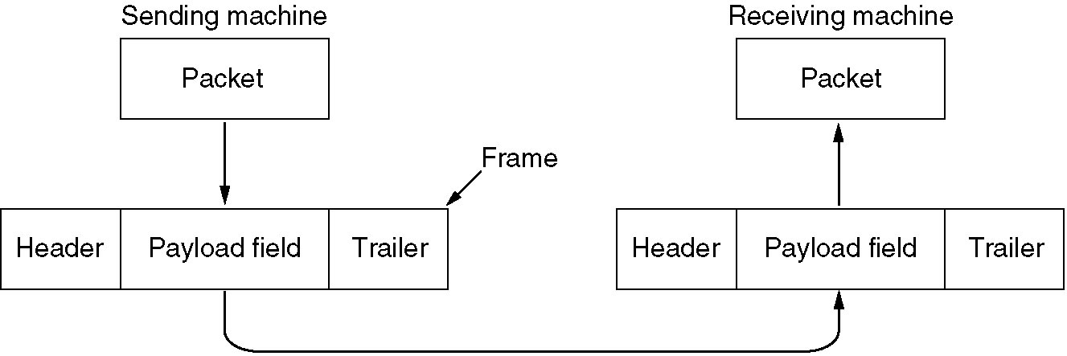
Functions of the Data Link Layer (2)
Relationship between packets and frames.

Slide 5
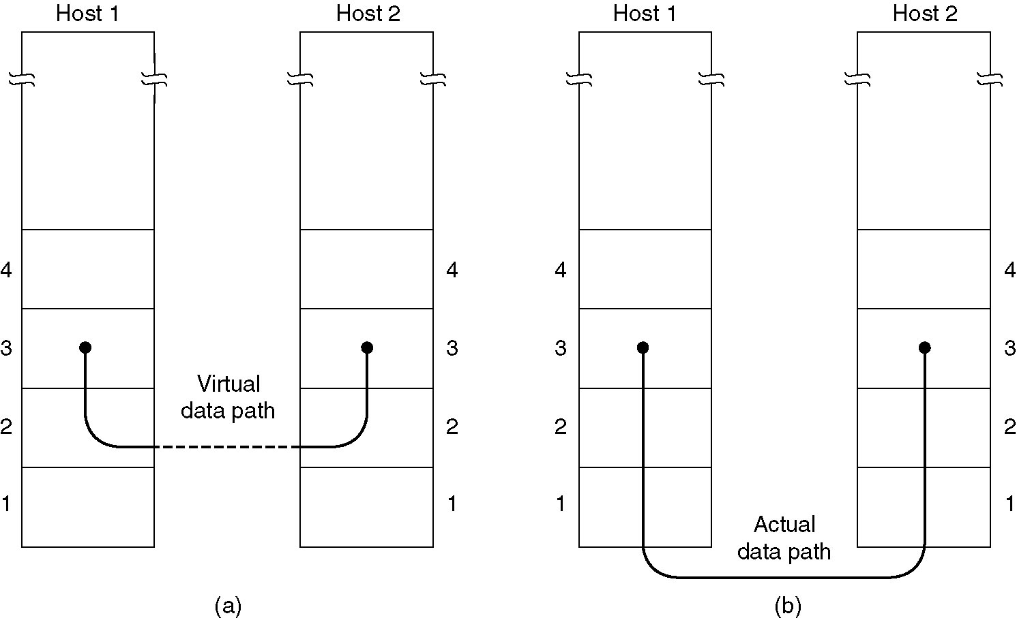
Services Provided to Network Layer
(a) Virtual communication.
(b) Actual communication.

Slide 6
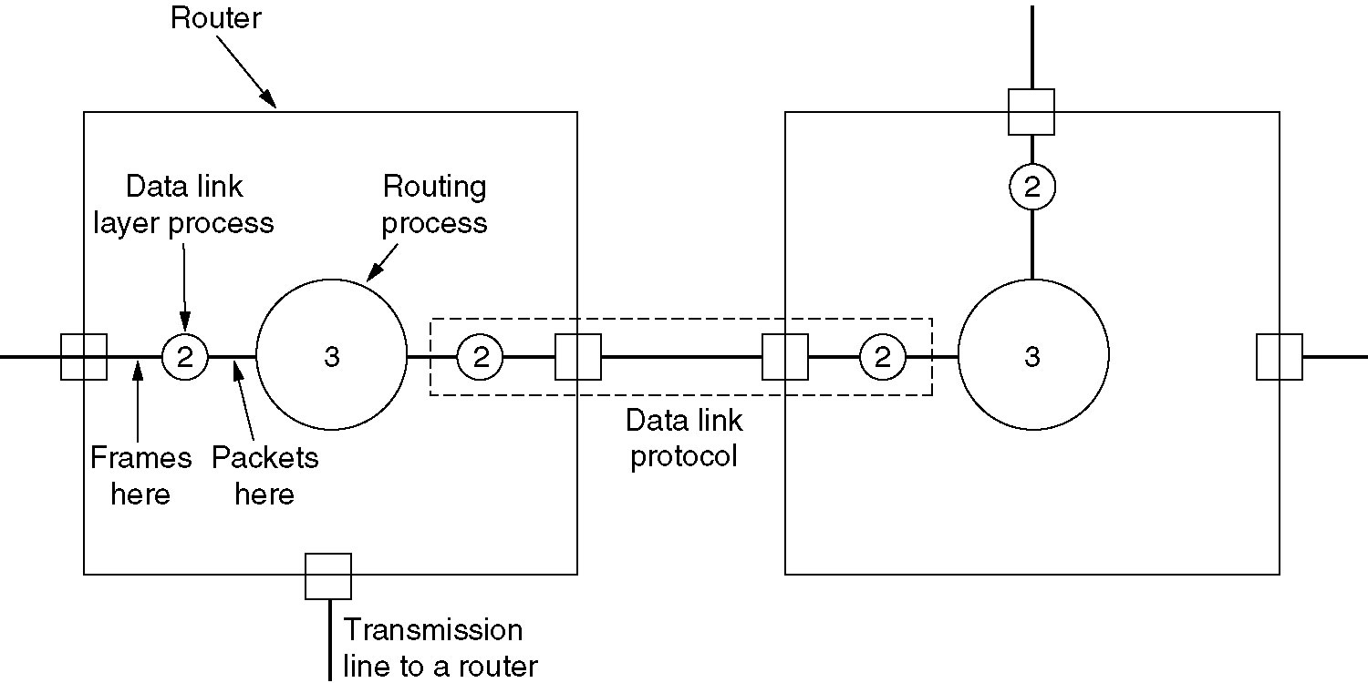
Services Provided to Network Layer (2)
Placement of the data link protocol.

Slide 7
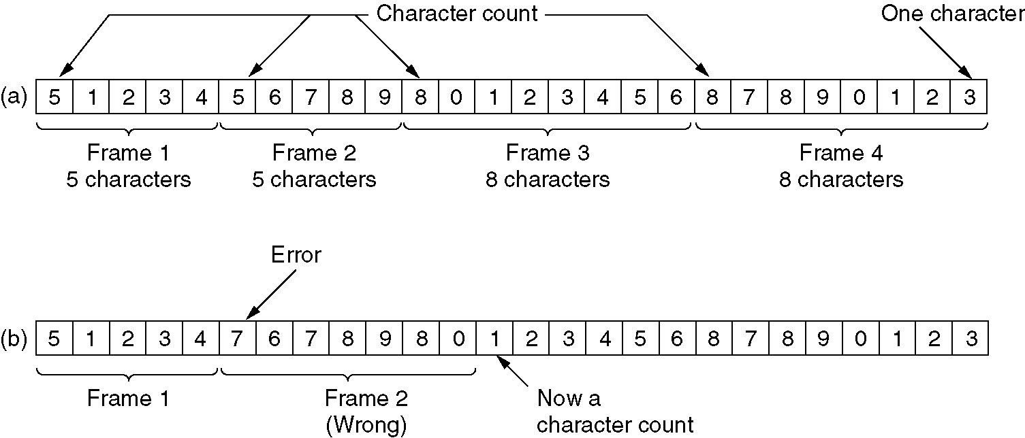
Framing
A character stream. (a) Without errors. (b) With one error.

Slide 8
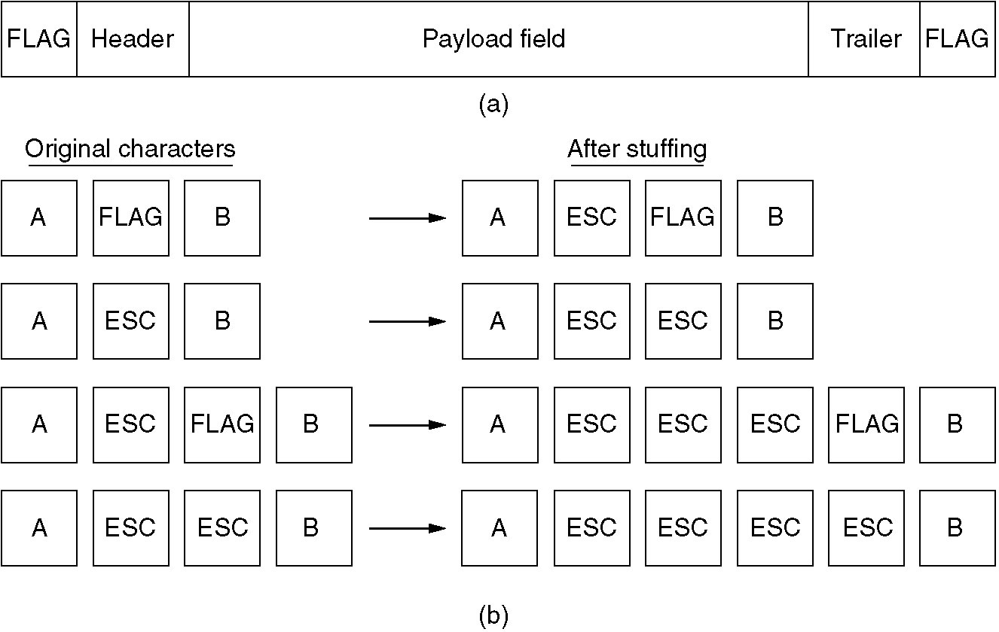
Framing (2)
(a) A frame delimited by flag bytes.
(b) Four examples of byte sequences before and after stuffing.

Slide 9
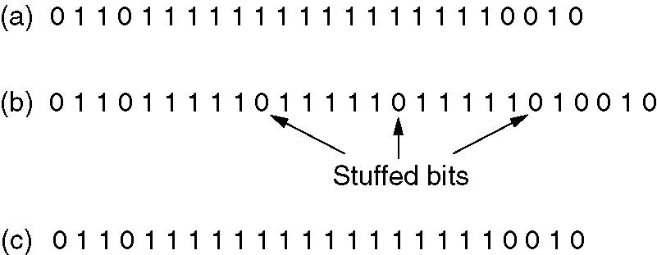
Framing (3)
Bit stuffing
(a) The original data.
(b) The data as they appear on the line.
(c) The data as they are stored in receiver’s memory after destuffing.

Slide 10
Error Detection and Correction
Error-Correcting Codes
Error-Detecting Codes

Slide 11
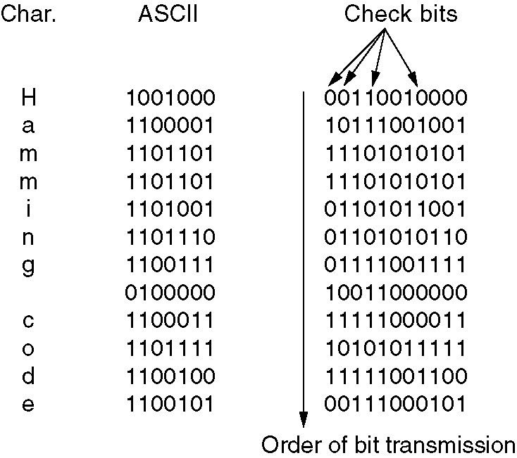
Error-Correcting Codes
Use of a Hamming code to correct burst errors.

Slide 12
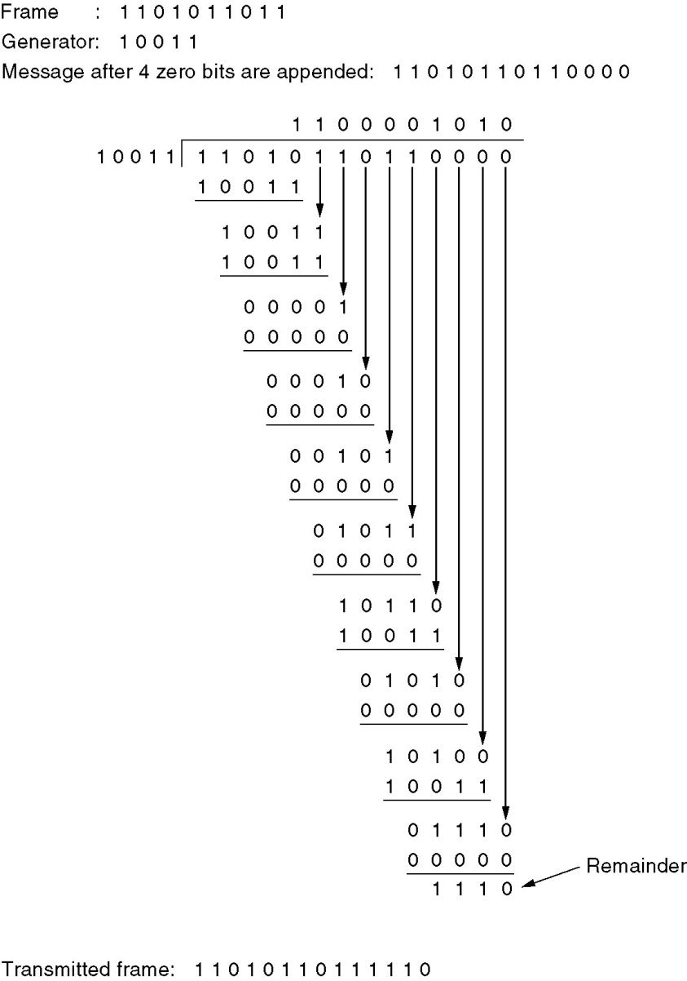
Error-Detecting Codes
Calculation of the polynomial code checksum.

Slide 13
Elementary Data Link Protocols
An Unrestricted Simplex Protocol
A Simplex Stop-and-Wait Protocol
A Simplex Protocol for a Noisy Channel

Slide 14
Sliding Window Protocols
A One-Bit Sliding Window Protocol
A Protocol Using Go Back N
A Protocol Using Selective Repeat

Slide 15
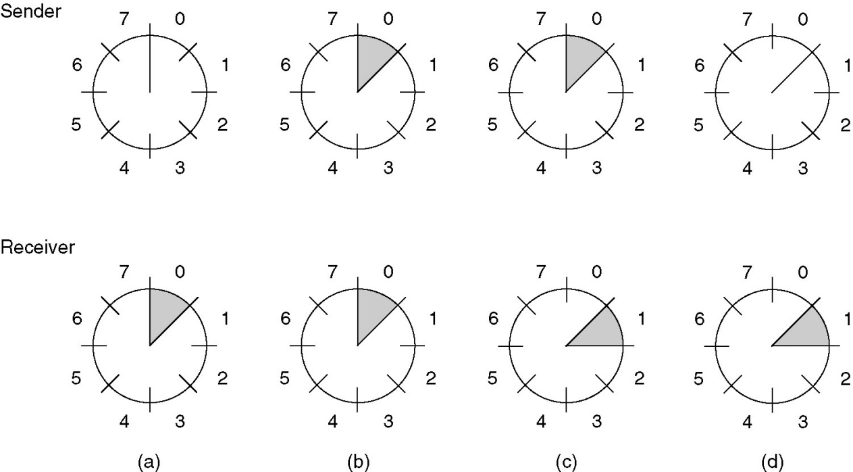
Sliding Window Protocols (2)
A sliding window of size 1, with a 3-bit sequence number.
(a) Initially.
(b) After the first frame has been sent.
(c) After the first frame has been received.
(d) After the first acknowledgement has been received.

Slide 16
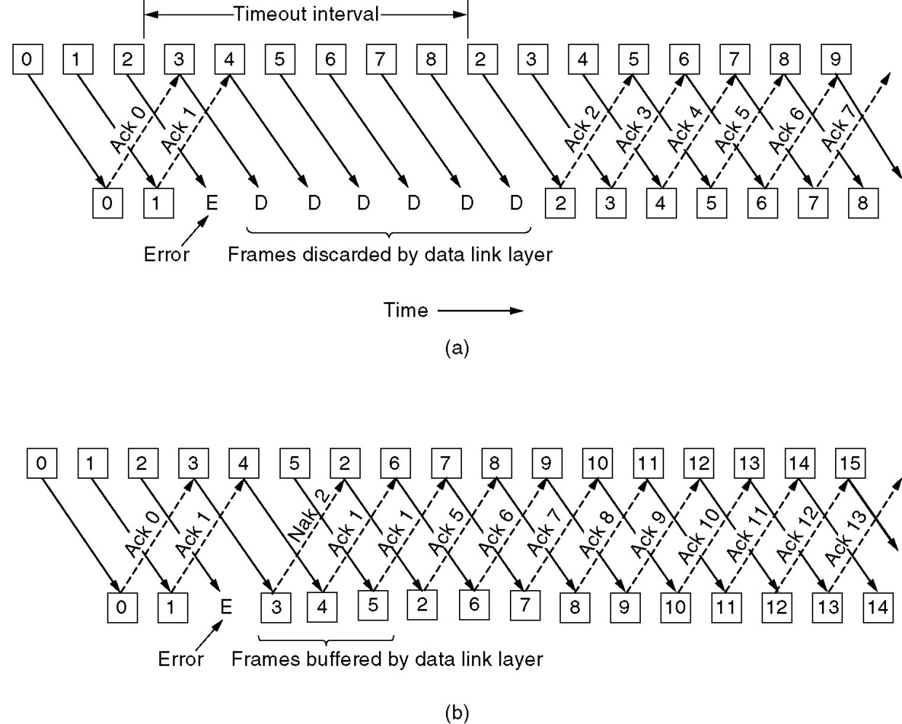
A Protocol Using Go Back N
Pipelining and error recovery. Effect on an error when
(a) Receiver’s window size is 1.
(b) Receiver’s window size is large.

Slide 17
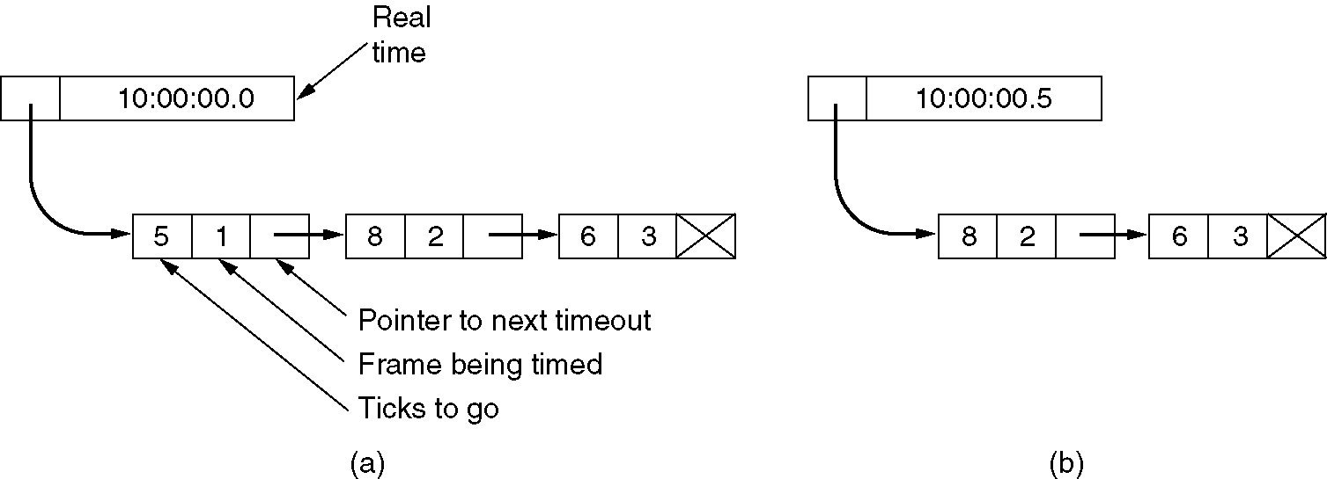
Sliding Window Protocol Using Go Back N (2)
Simulation of multiple timers in software.

Slide 18
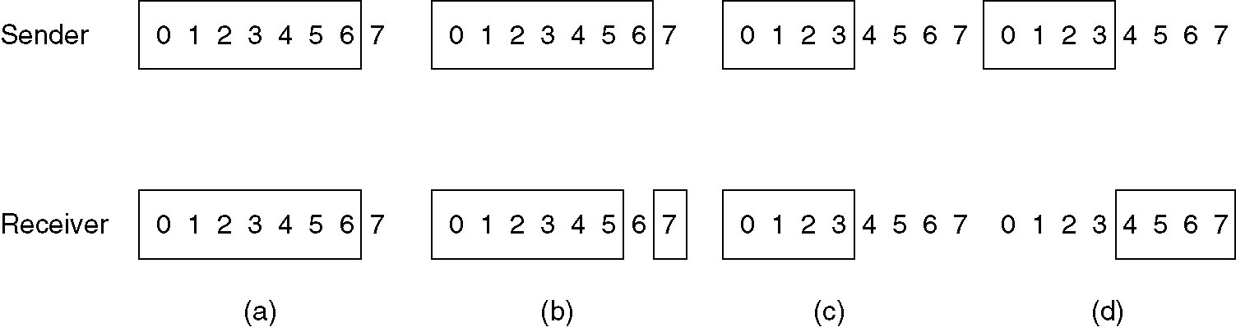
A Sliding Window Protocol Using Selective Repeat (5)
(a) Initial situation with a window size seven.
(b) After seven frames sent and received, but not acknowledged.
(c) Initial situation with a window size of four.
(d) After four frames sent and received, but not acknowledged.

Slide 19
Protocol Verification
Finite State Machined Models
Petri Net Models

Slide 20
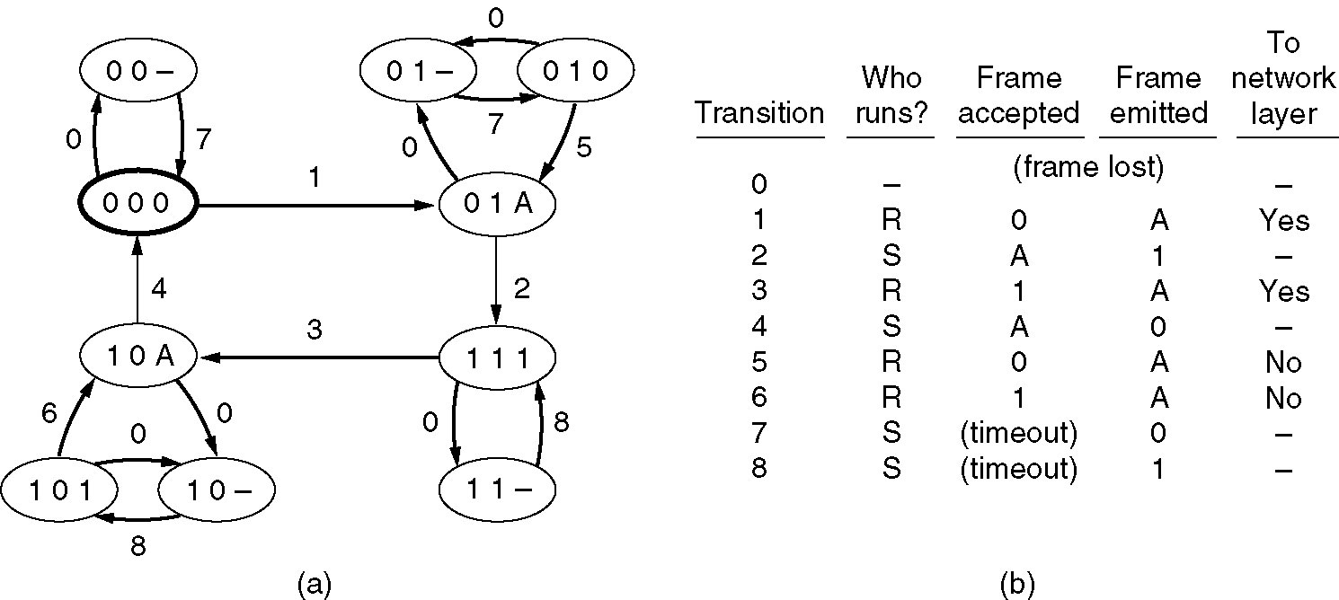
Finite State Machined Models
(a) State diagram for protocol 3. (b) Transmissions.

Slide 21
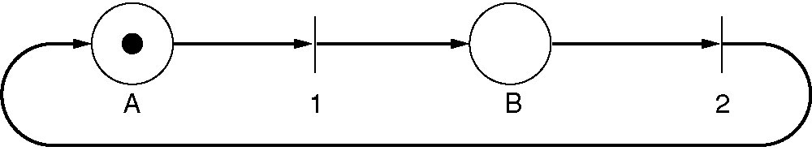
Petri Net Models
A Petri net with two places and two transitions.

Slide 22
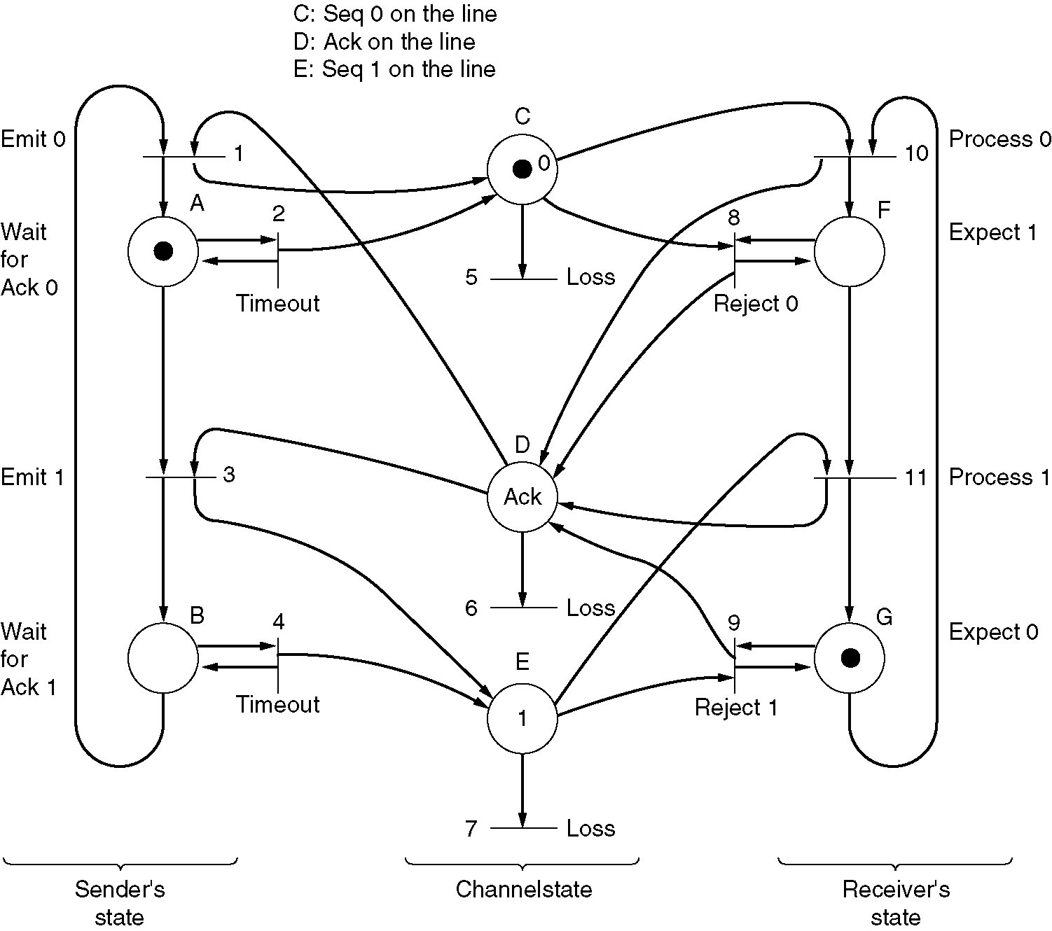
Petri Net Models (2)
A Petri net model for protocol 3.

Slide 23
Example Data Link Protocols
HDLC – High-Level Data Link Control
The Data Link Layer in the Internet

Slide 24
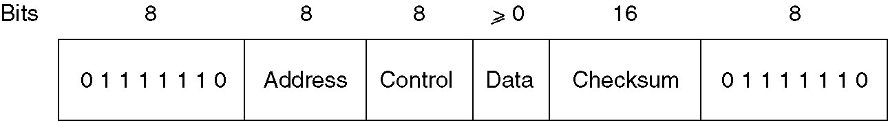
High-Level Data Link Control
Frame format for bit-oriented protocols.

Slide 25
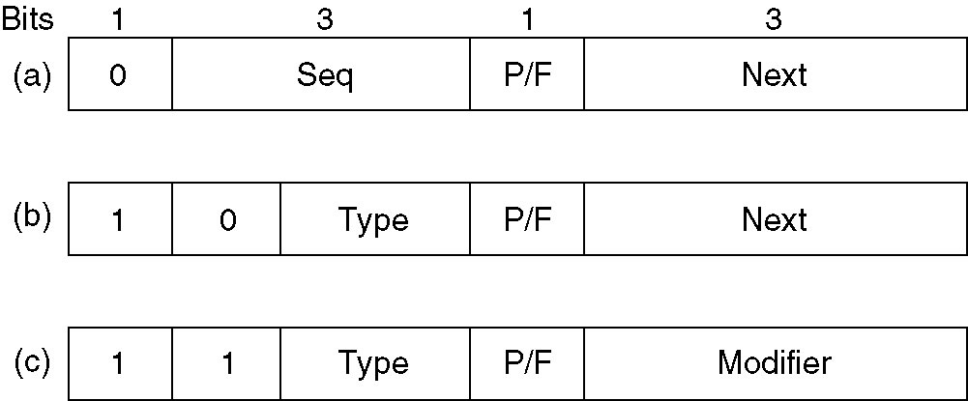
High-Level Data Link Control (2)
Control field of
(a) An information frame.
(b) A supervisory frame.
(c) An unnumbered frame.

Slide 26
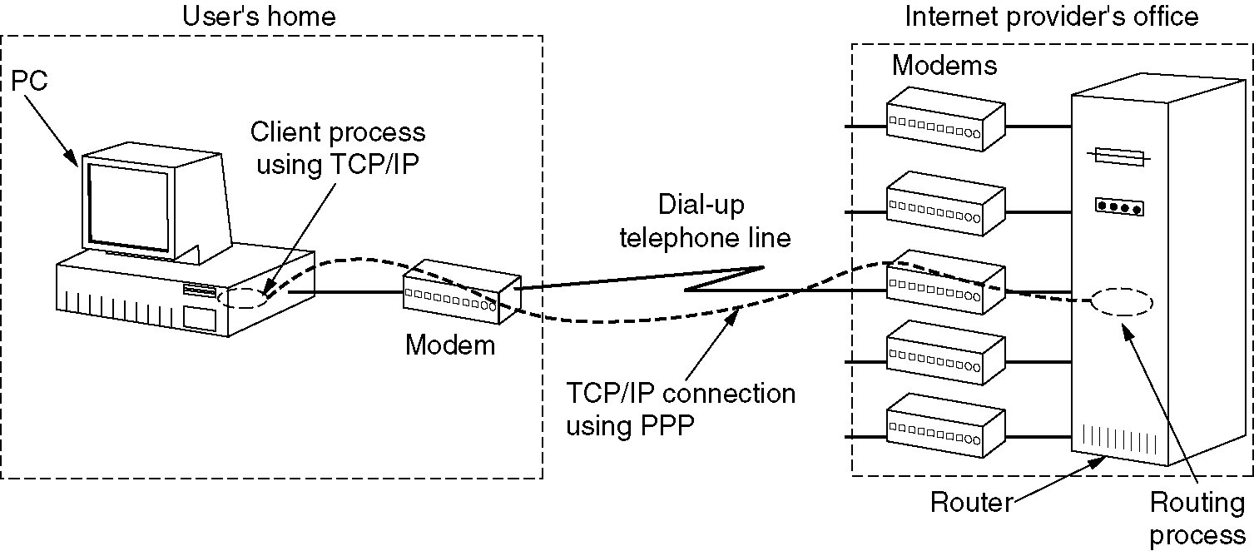
The Data Link Layer in the Internet
A home personal computer acting as an internet host.

Slide 27
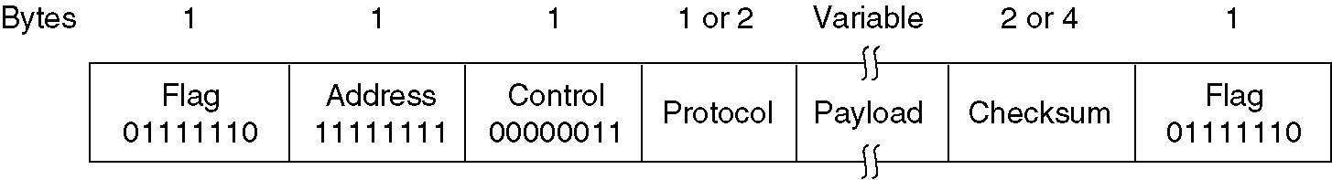
PPP – Point to Point Protocol
The PPP full frame format for unnumbered mode operation.

Slide 28
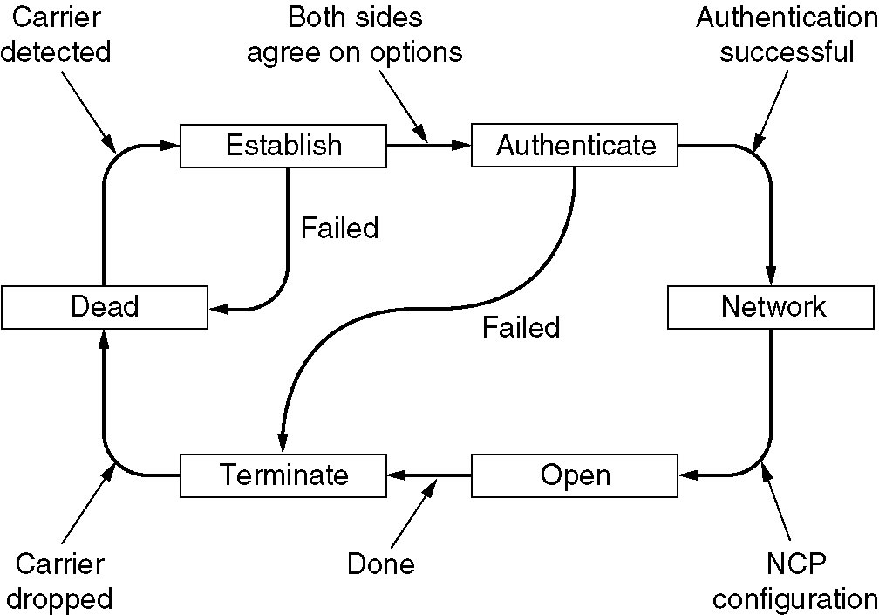
PPP – Point to Point Protocol (2)
A simplified phase diagram for bring a line up and down.

Slide 29
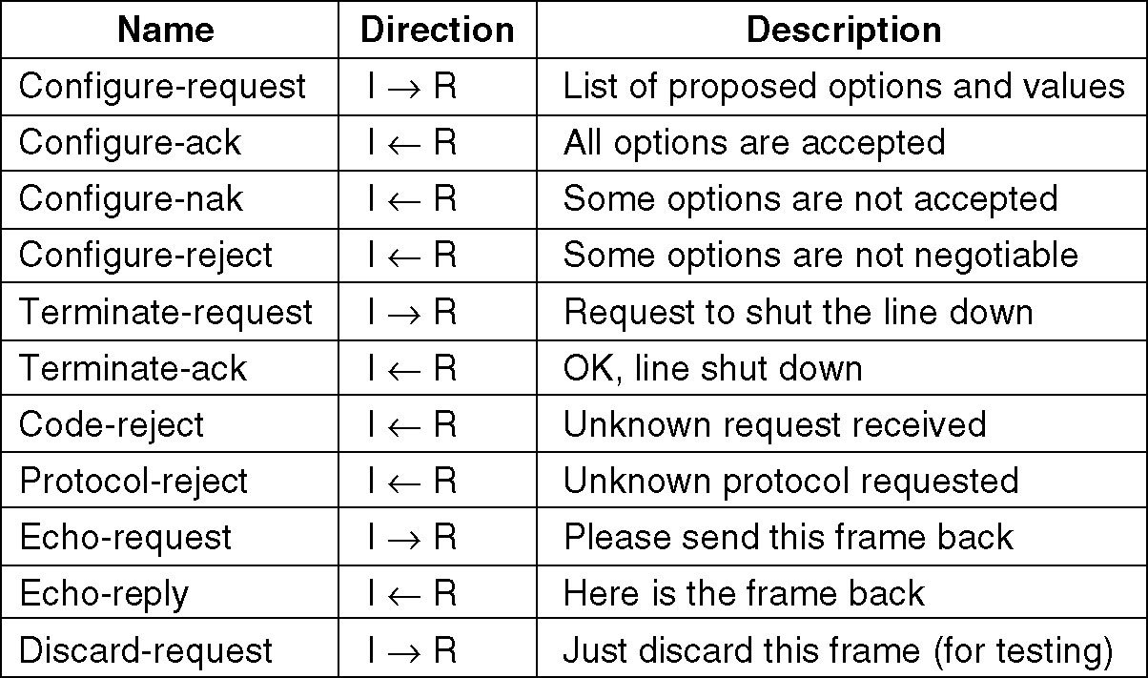
PPP – Point to Point Protocol (3)
The LCP frame types.

